Slide 1
Preparation of the histological section
Lecturer/Sura Haddad
Msc in Histology
Collage of Dentistry ,University of Basrah
Department of Oral Diagnosis

Slide 2
Learning objectives:
At the end of this lecture, you will be able to do
Define the microscopical examination
distinguish between the soft and hard tissue in preparation section
Define each steps in the preparation and know the aims and the factors effects of each step.
Explore the types of sectioning and the advantage of each type

Slide 3
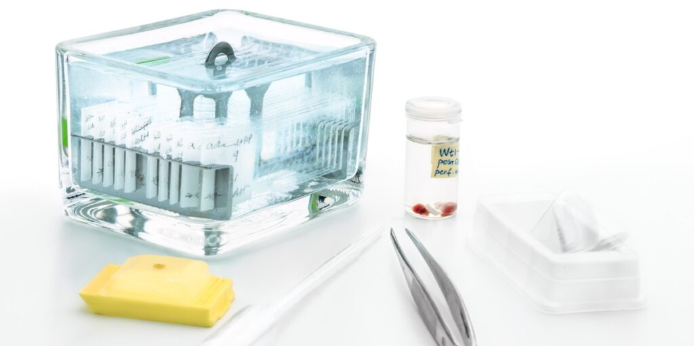
how can you prepare a histological slide?

Slide 4
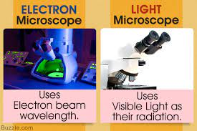
Note :
The microscopic examination of tissue sections and their proper preparation is important in the study of oral tissue morphology.
various types of microscopes and histological techniques is important to learn. This helps to study the structure and function of oral tissues.
Two types of microscopes are most common : light microscope and electron microscope.

Slide 5
So
Thick tissue
Thin tissue

Slide 6
To prepare the slide
Fixation
By formalin
Dehydration
By alcohol
Clearing
By xylene
Embedding
By paraffin
Sectioning
By microtome
Staining
H&E or special stain

Slide 7
Preparation of specimen for microscopy
Type of tissue
Soft tissue like (gingiva, cheek, tongue, lip, salivary gland,
Fixation
Dehydration, clearing and infiltration
Hard tissue (the tissue containing bone or teeth(
decalcified

Slide 8
Fixation of the specimen
Inter formalin inside the tissue and pull out the water from cells
To
prevent autolysis and bacterial attack
fix the tissues so they will not change their volume and shape.
prepare tissue and leave it in a condition which allow clear staining of sections.
leave tissue as close as their living state as possible.

Slide 9
PH,tempreture
Penetration of fixative
Volume of tissue
Factors effect of fixation

Slide 10
Processing of the tissue
Dehydration
remove fixative from the tissue and replace them with dehydrating fluid (alcohol )
The specimen is gradually dehydrated by being passed through a series of increasing percentages of alcohol (60%, 70%, 80% and 95% and absolute alcohol).

Slide 11
Clearing
The paraffin is not miscible with alcohol then need a fluid like xylene to miscible with paraffin .
Then the specimen is placed in a suitable container of melted paraffin wax, which has been in an oven at 65°C until it is completely infiltrated.

Slide 12
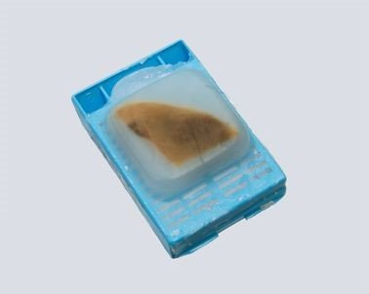
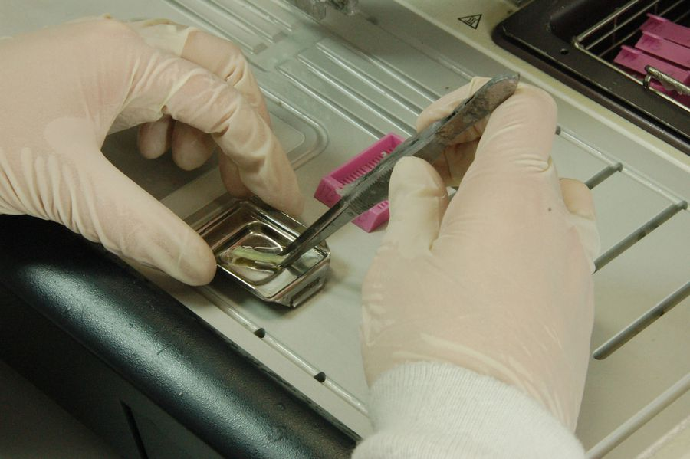
Embedding
This step in process by which tissues are surrounded by a medium such as paraffin wax which when solidified will provide sufficient external support during sectioning.
it is placed into a small container, covered with melted paraffin, and then allowed to harden

Slide 13
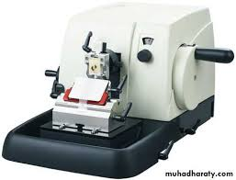
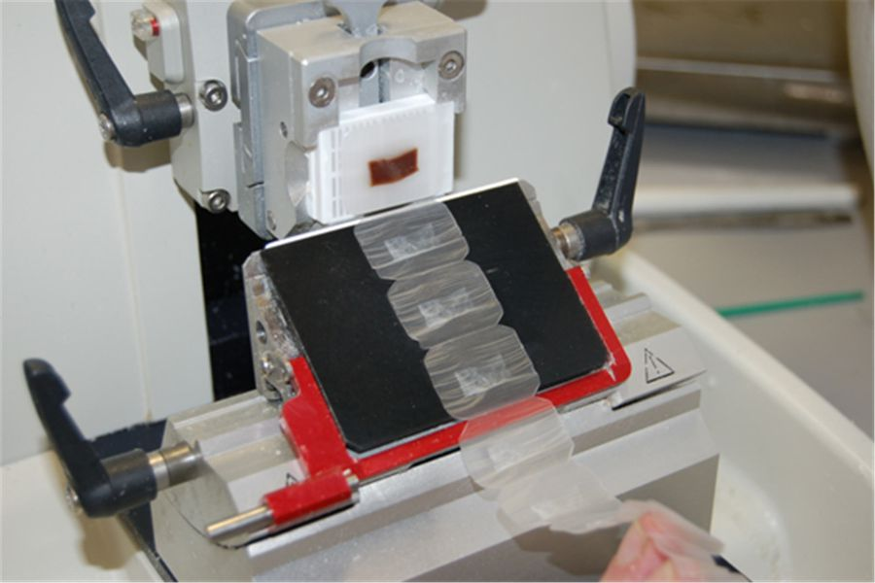
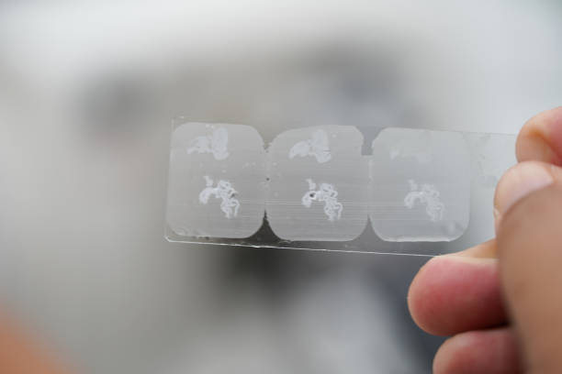
Sectioning of the specimen
The paraffin blocks are sectioned with a microtome
The microtome equal increments of the tissue thickness (usually from 4 to 10 microns).
Then sections are placed on glass slides

Slide 14
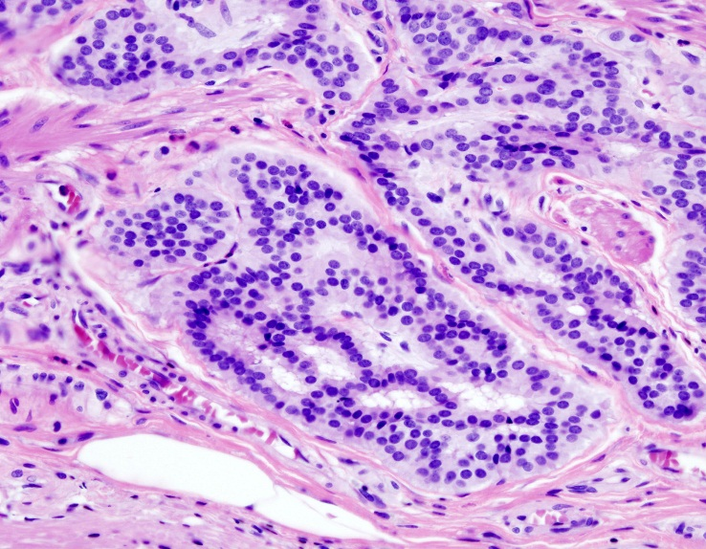
Staining the section
Paraffin is first removed from the section, then tissue is rehydrated and stain. The most commonly used stains in histology are hematoxylin and eosin.
Hematoxylin is a base; it colors the acidic components of the cells by bluish color
Eosin is an acid that dyes the basic components of the cells a pinkish color

Slide 15
Decalcified section for hard tissue
The specimens in this section must be decalcified (the hard substance of specimen removed by acid). This type is used for the tissue containing bone or teeth.
Enamel of the tooth contains 96% hard tissue.
Need to remove all the calcified and to be soft to start the processing steps.

Slide 16
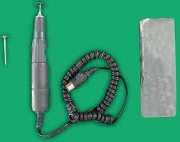
Ground sections for calcified tissue
Specimens of calcified tissue may be ground into thin section such as bone and undecalcified tooth.
This is done by slicing the undecalcifed specimen into a section of about 1mm on a revolving stone or disc and by grinding on lathe wheel

Slide 18
Frozen section for soft tissues
This type is used to examined the pathological tissue specimens immediately
when the reagent used for embedding would destroy the tissue characteristics that are to be studied
specimen of soft tissue may be frozen and sectioned with freezing microtome (cryostat) without being embedded.
The specimen covered by O.C.T. (optimal cutting temperture) which was so fast frezon

Slide 19
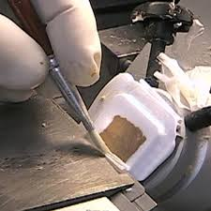
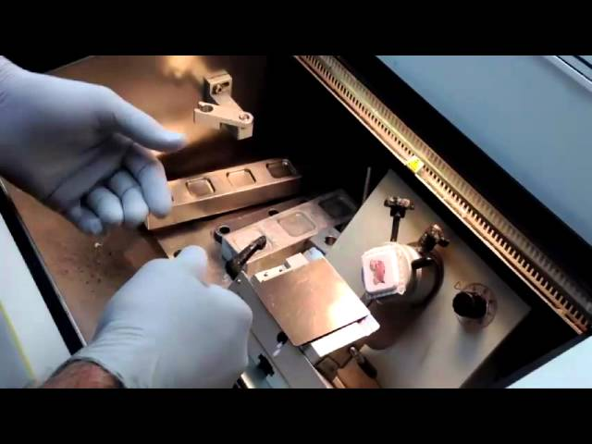
Frozen section

Slide 20
immunohistochemistry process
. The IHC is a laboratory technique to determination the region of protein in the tissue by antibody and antigen complex.
used to help diagnose diseases, such as cancer and differ between types of them.
the thickness of tissue section (2-4µm) and the slide which is used for IHC is a special slide provides by adhesion to the tissue section to tolerate the pressure and high temperature.

Slide 21
